Slide 1

Celluer Automated External Defibrillator

Slide 2
CONTENT
CAED BATTERY
OREL Battery Specifications
Battery manufacture
Control Board
PSOC
Inputs/Outputs
CAED Circuit
High voltage Board
Charging Circuit
Capacitor
H-Bridge circuit
Inner selector
Internal Discharge circuit
Outer selector
Connector
APP
0

Slide 3
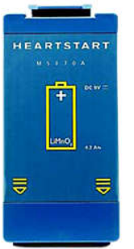
CAED
OREL Battery Specifications
Type: Lithium Manganese Dioxide
high-energy
long-lasting battery
Voltage: 9 volts
Capacity: 4.2 ampere-hours (Ah)
Weight: 1.5 pounds (0.68 kg), or below
Size: 13.34 cm x 9.53 cm x 3.81 cm or below.
Shelf life: 2-4 years
Operating temperature range: temperatures ranging from 32°F (0°C) to 122°F (50°C).
Charging time: The battery can be fully charged in under four hours
Run time: minimum of 200 shocks or four hours of monitoring

Slide 4
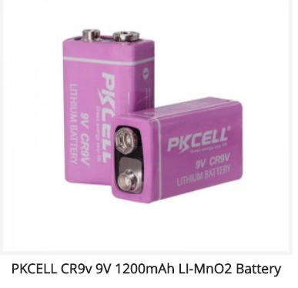
Battery Manufacturer
Lithium manganese dioxide
4 Batteries
9v nominal voltage
1200mAh
$500 for 1 battery

Slide 5
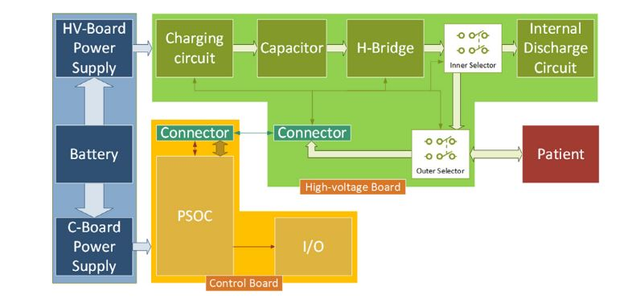
Circuit Diagram
20

Slide 6
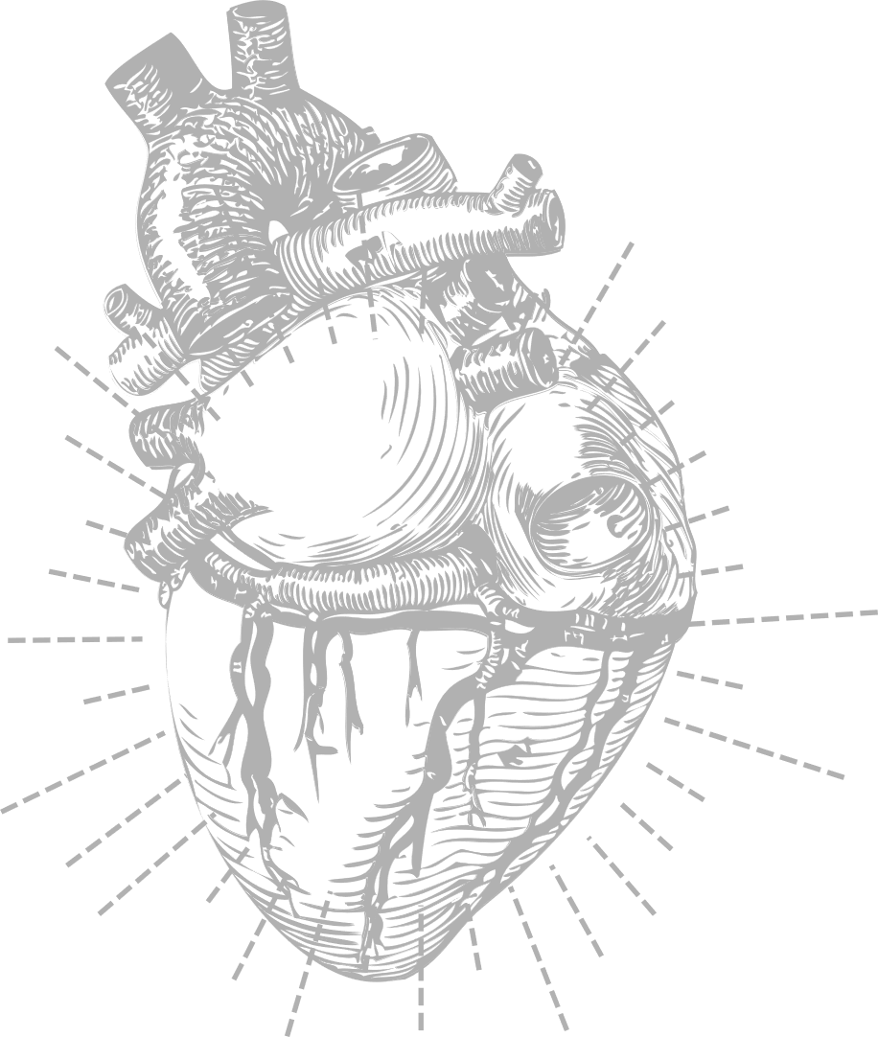
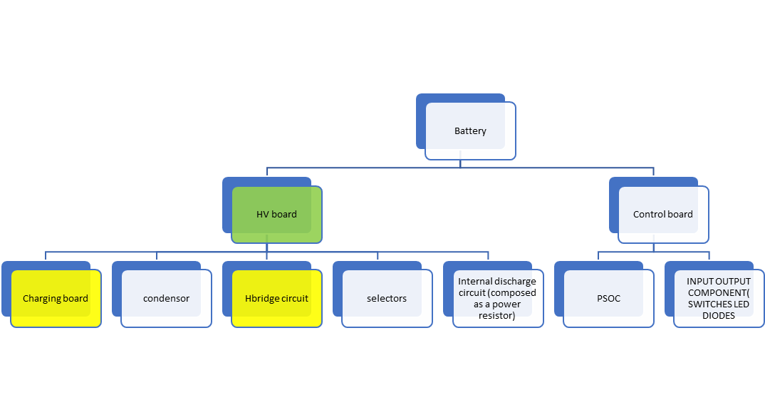

Slide 7
High Voltage Board
HV-B contains the circuitry necessary to perform defibrillation
capacitor, used to store the energy to be released to the patient
charging circuit, which rapidly charges the capacitor
H-Bridge circuit, required to perform biphasic defibrillation
internal discharge circuit, used to dump the unused residual energy ( discharge capacitors)
two selectors, used to isolate the patient from the capacitor, and to route the ECG signal to the C-B.
20

Slide 8
Charging Circuit
Charging Circuit Self oscillating fly back convertor
The purpose of the CAED charging circuit is to charge the high-voltage capacitor to store the energy needed to deliver an electrical shock to the heart in case of cardiac arrest.

Slide 9
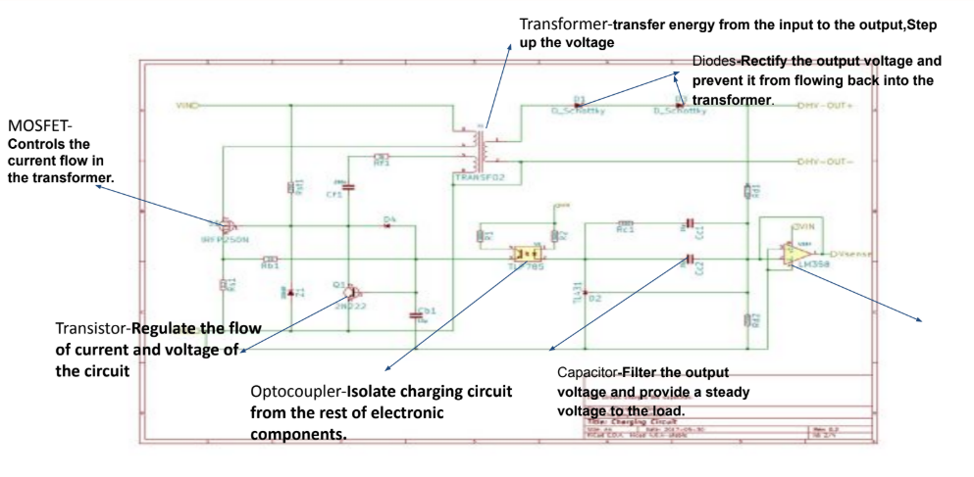
Charging Circuit
LM358 OP AMP -accurate and stable control of the charging process.

Slide 10
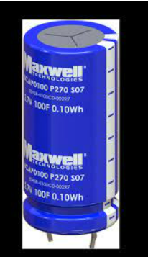
Capacitor
Nesscap ESHSR-001R5C4R6N
Type of ultra capacitor(super capacitor)
Design to store and release high amount of energy quickly
Low ESR ( Equilent series resistance
High power density

Slide 11
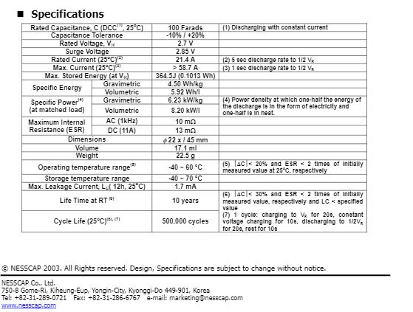
Capacitor

Slide 12
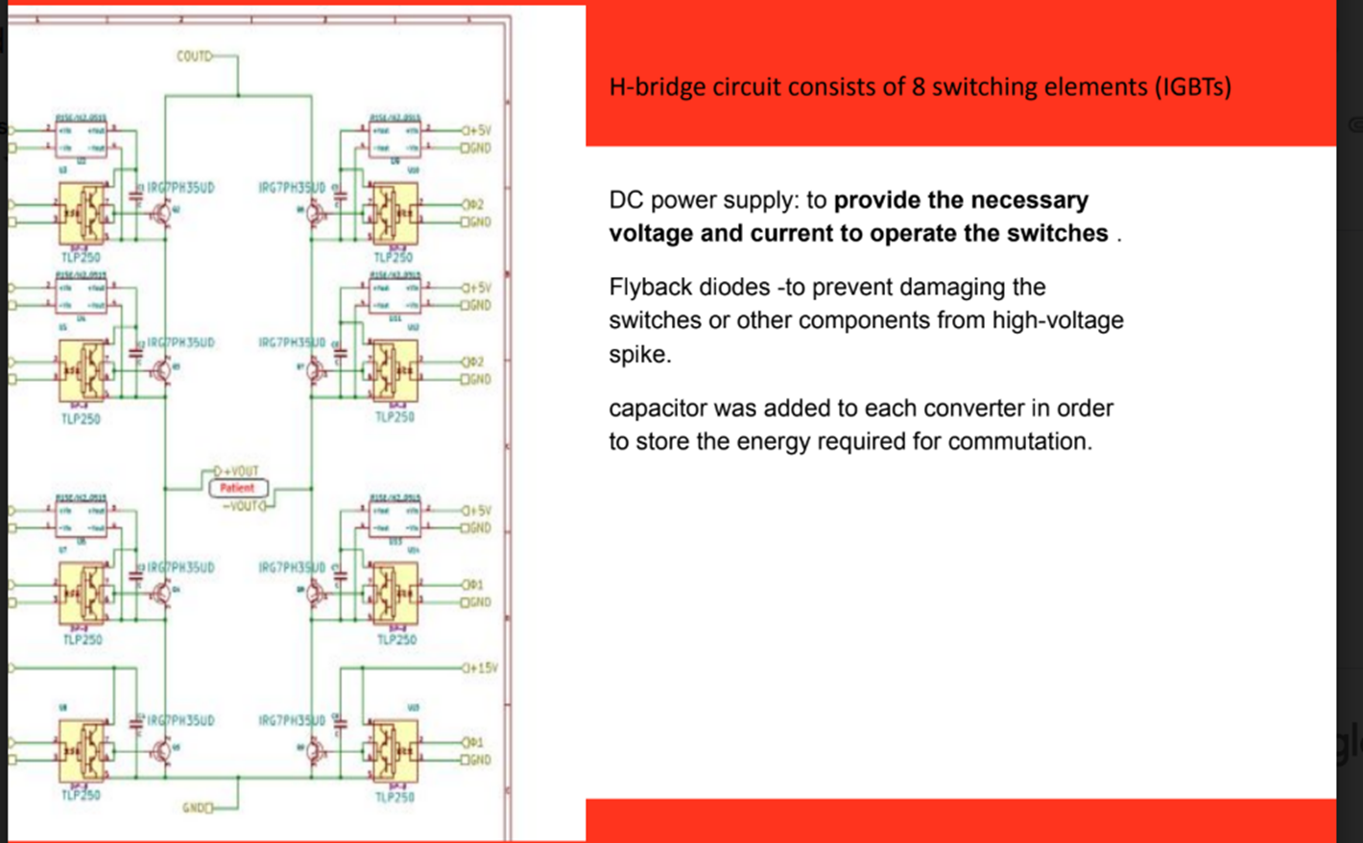
H- bridge circuit

Slide 13
Internal discharge circuit
Deliver the high-energy electrical shock to the heart by discharging the charged capacitor of the AED in a controlled manner.

Slide 14
Connectors & Selectors
Electrode Connectors: These connectors allow the user to attach the electrode pads to the AED device.
Selector Buttons: ex - select the language of the voice prompts
- switch between adult and child modes.
Battery Connector

Slide 15
Connectors & Selectors
Power Switch: AED on and off.
Shock Button

Slide 16
Control board
Microprocessor: Brain of the device.
Electrodes: These are the pads that are attached to the patient's chest to deliver electrical shocks.
Input /outputs interfaces
Audio system: The control board manages the audio output of the device, including voice prompts and warnings.

Slide 17
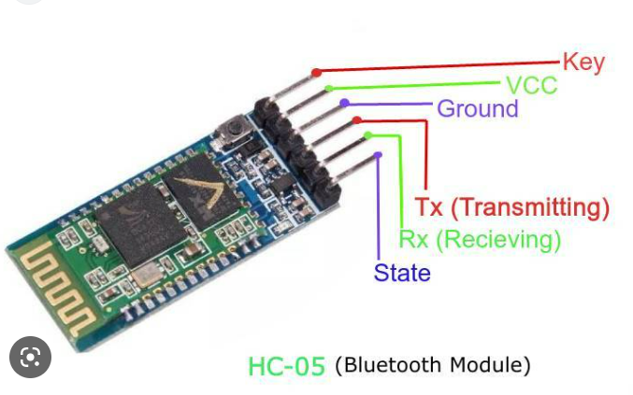
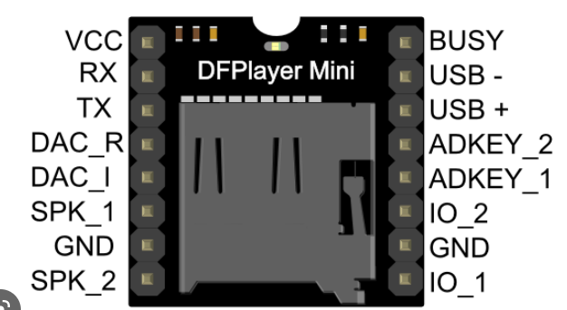
Control board
HC-O5 Bluetooth module
Audio module DFPlayer mini module

Slide 18
APP
Operational check (Sound message) system
ECG History
ECG Report (present )
Operational Check
Exit clinical mode
Operational check summary
Run operational check
Auto test summary
Exit
YES
NO

Slide 19
Operational check
Reference number 1st step
Serial num 2nd step
Last operational check Date/(pass/fail)
General system test: in progress pass
Therapy Knob : pass
Charge button : pass
Shock button : pass
Audio test : pass
Therapy delivery test : pass /external /paddles
Leads ECG test : pass ECG cables
Pads/paddles/ECG test : pass external paddles
Battery test : pass
Printer test : pass
Instruction messages (with sound message system)

